Slide 1
Project 4: Acrobot Control
By: Anshul Bharati

Slide 2
Contents
Explanation of Problem
Setup of Notebook
Exploration
Approach
Baseline Model
Improved Model
Future Improvements

Slide 3
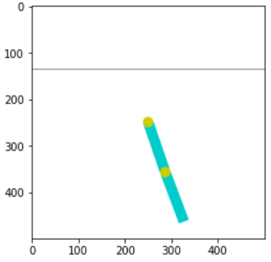
Explanation of Acrobot Control Problem
Acrobot System consists of:
2 joints
2 links
Middle joint is actuated (CW, CCW, neither)
Goal:
Get bottom link above specified height

Slide 4
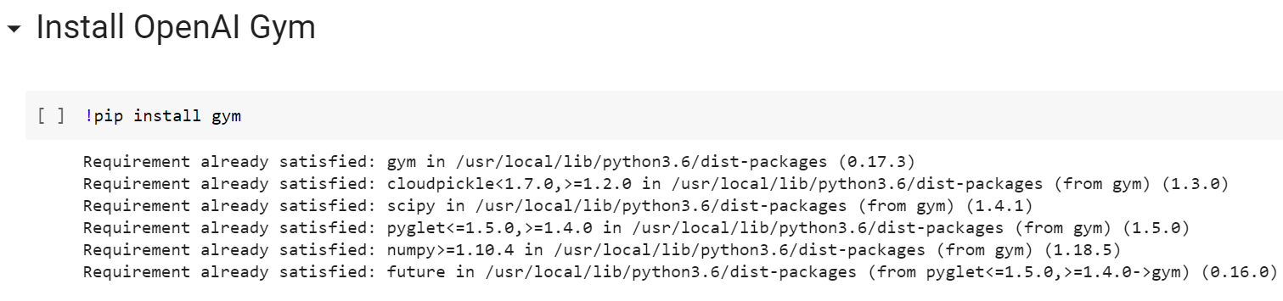
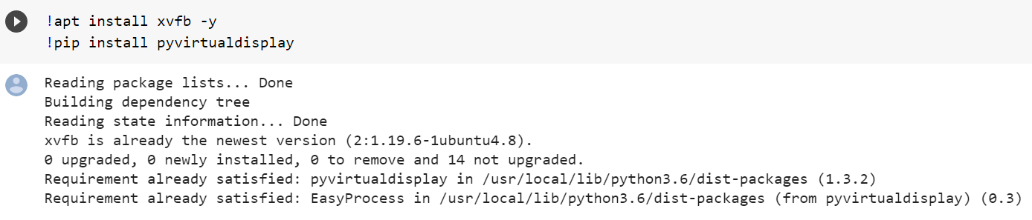
Setup of Notebook

Slide 5
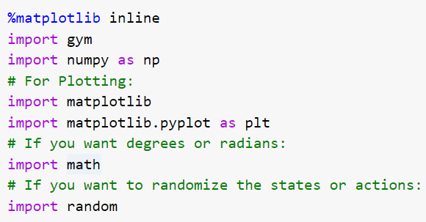
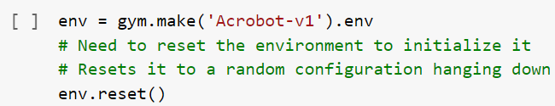
Setup of Notebook

Slide 6
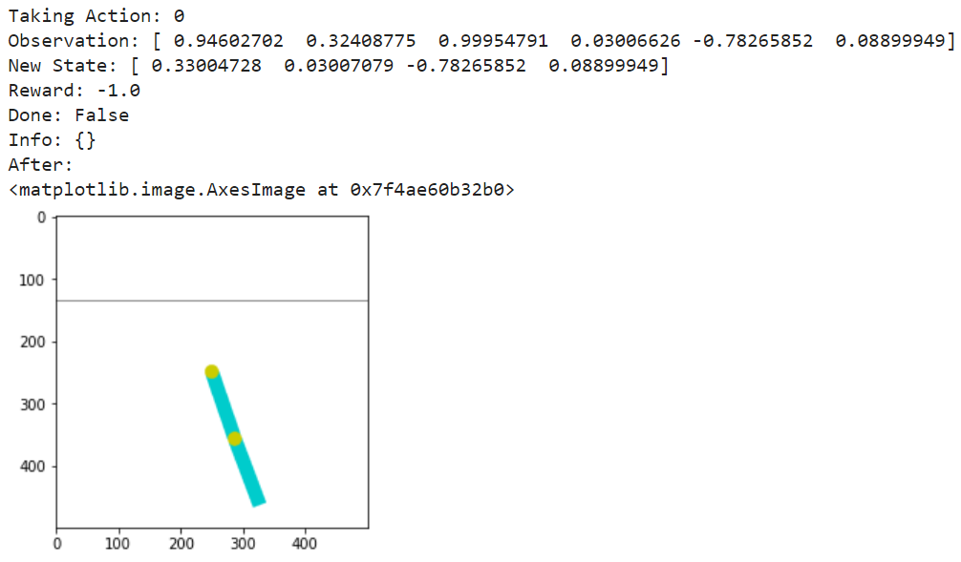
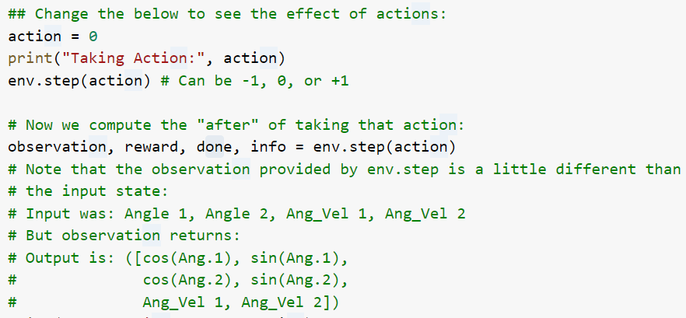
Exploration

Slide 7
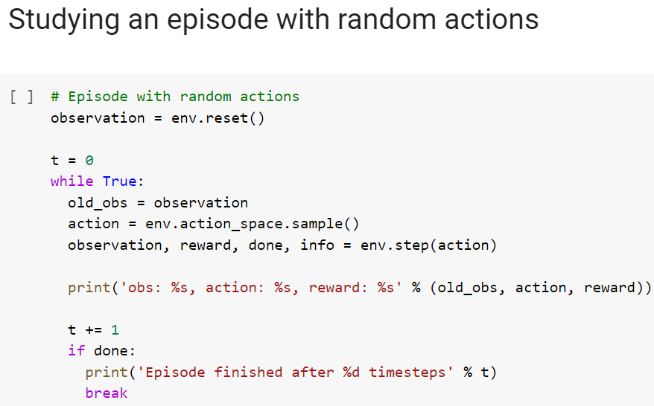
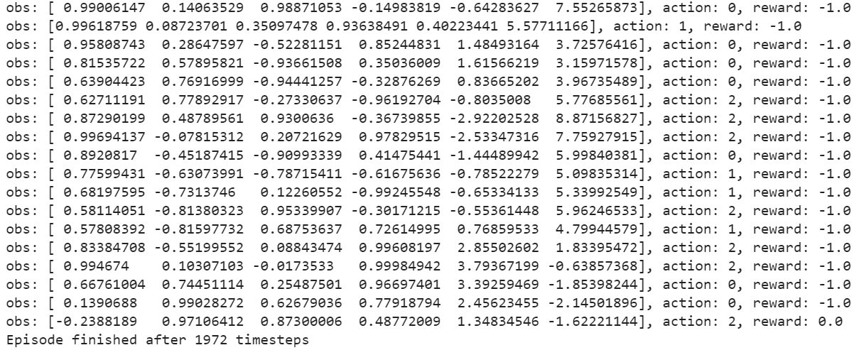
Exploration
Picked random actions from sample space
Printed observation, reward, done, info, and number of timesteps in episode

Slide 8
Exploration
Showed how reward function works
Need a way to store these observations
Polar Grid (?)
https://github.com/vinhvu200/Windy-Grid-World/blob/master/Q-Learning.ipynb

Slide 9
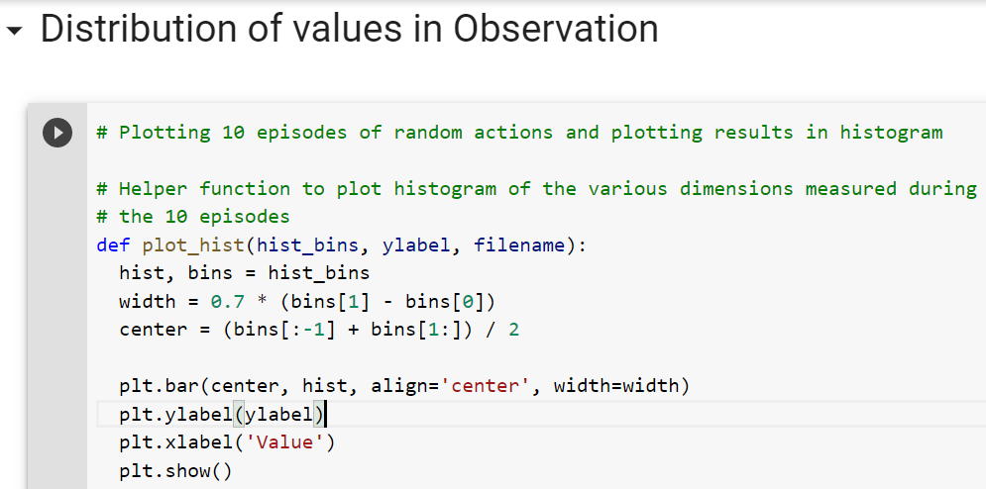
Exploration

Slide 10
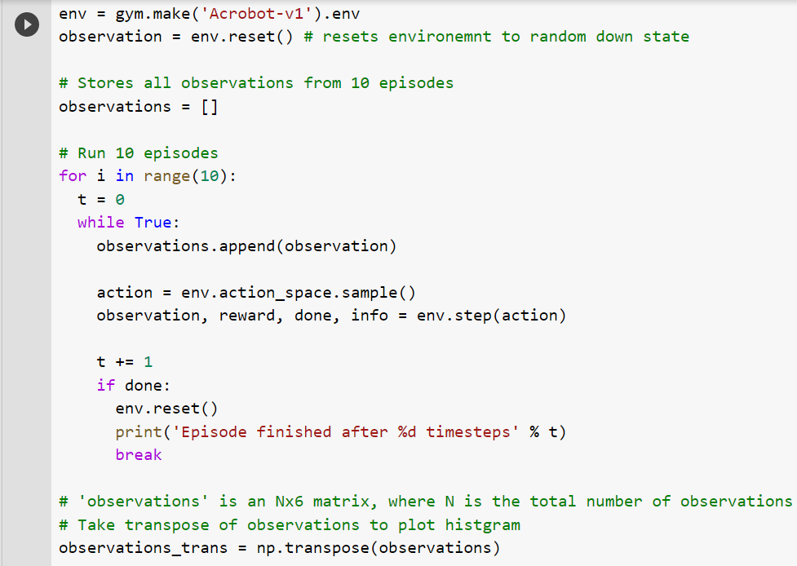
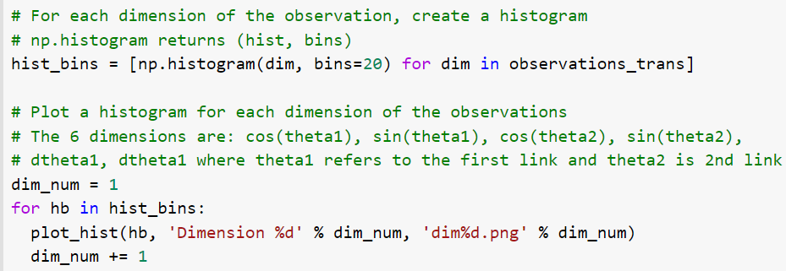
Exploration

Slide 11
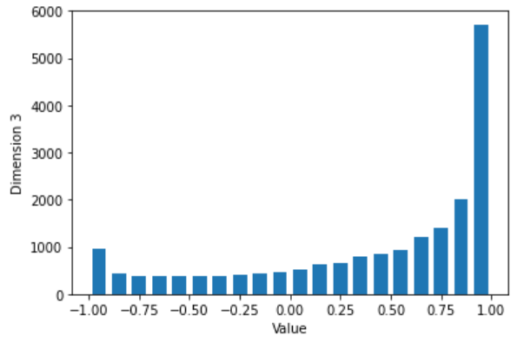
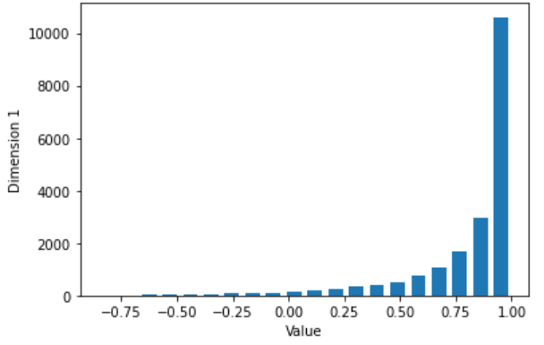
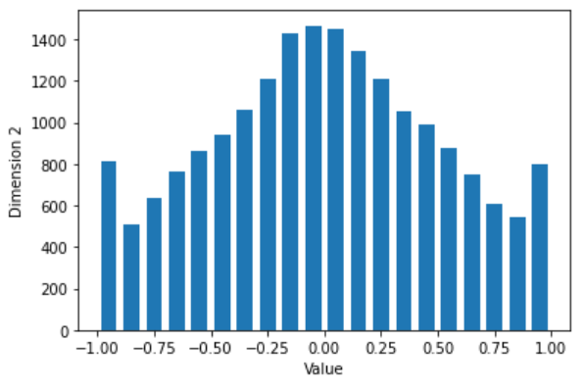
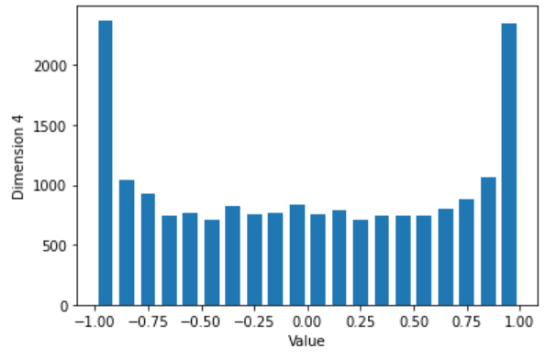
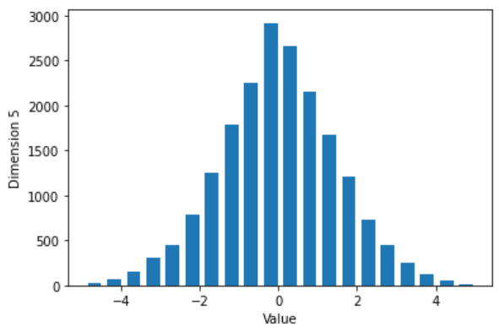
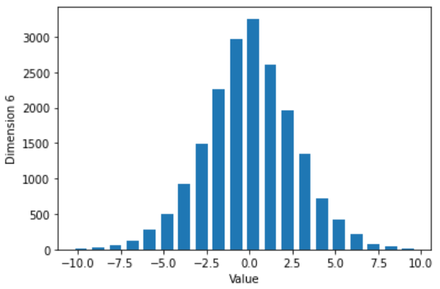
Exploration

Slide 12
Exploration
Emphasized need to store observations
Model must pick actions to get out of unwanted states
Need a way to evaluated the model

Slide 13
Original Approach
Looked at various implementations on github
Watched videos to get a better understanding of problem
Watched reinforcement learning videos
Stuck for weeks
Overwhelmed by what needed to be done

Slide 14

Final Approach
Knew reinforcement learning was the key
Looked at libraries that are used to implement RL
Found a tutorial for a similar problem
https://colab.research.google.com/github/tensorflow/agents/blob/master/docs/tutorials/1_dqn_tutorial.ipynb#scrollTo=E9lW_OZYFR8A
https://en.wikipedia.org/wiki/TensorFlow#/media/File:TensorFlowLogo.svg

Slide 15
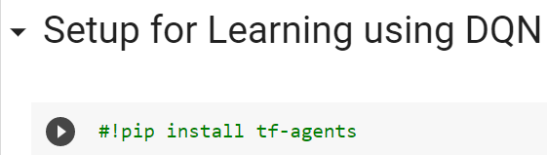
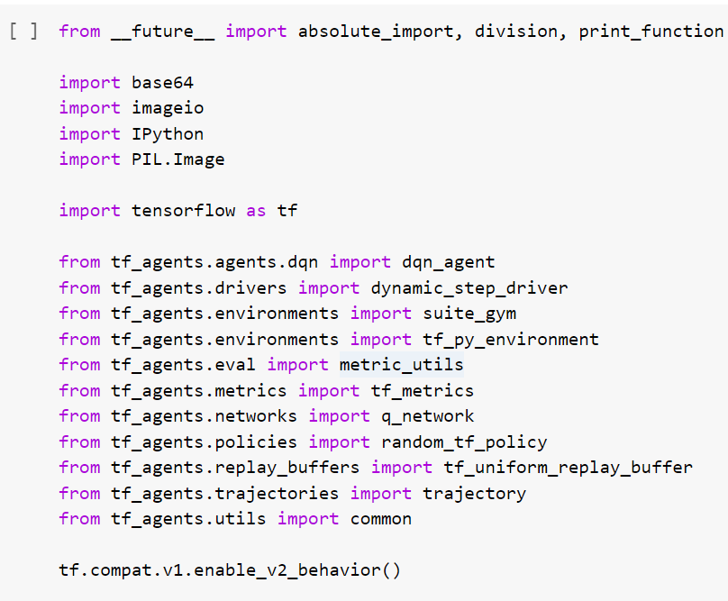
Baseline Model
Utilizes Deep Q-Networks

Slide 16
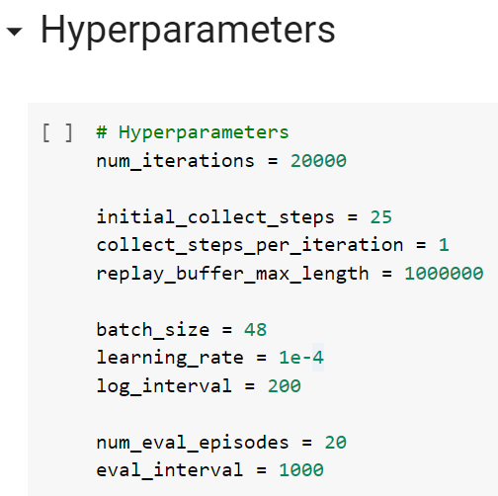
Hyperparameters for Baseline Model
Settled on these hyperparameters after testing

Slide 17
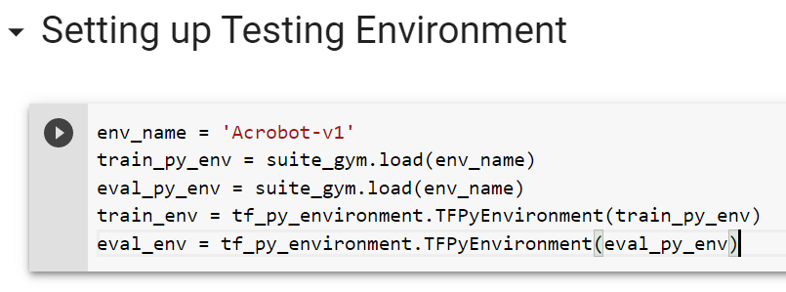
Environment

Slide 18
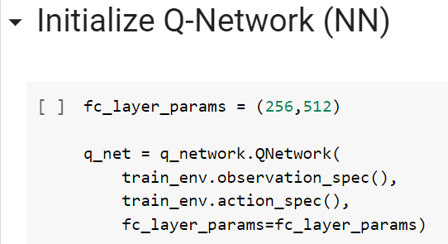
Neural Network
Settled on these number by testing
Inspiration from: https://gist.github.com/avalcarce/c87ab375433088aa519e7135d22b7eb6

Slide 19
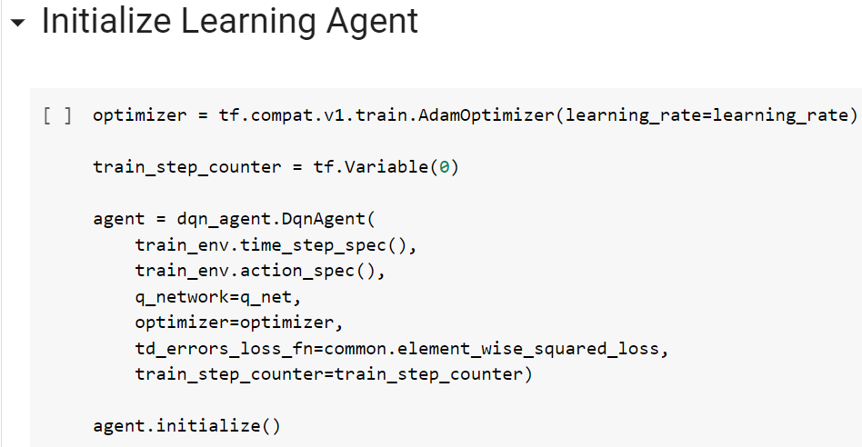
Initialize Learning Agent

Slide 20
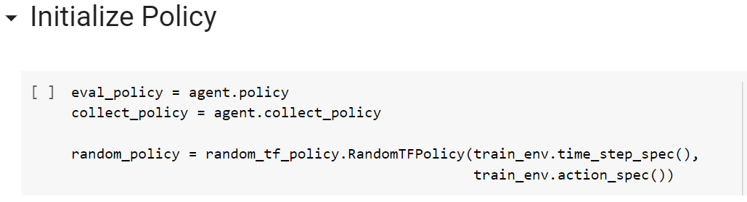
Policy

Slide 21
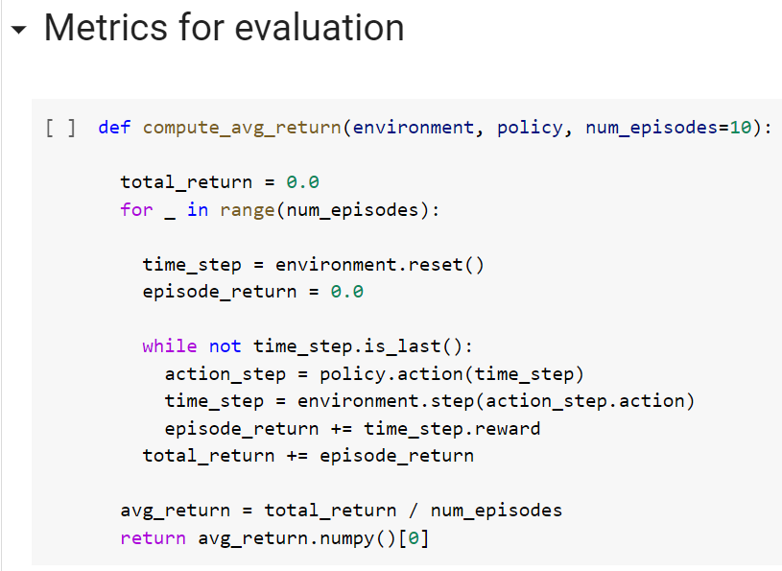
Metric of Evaluation

Slide 22
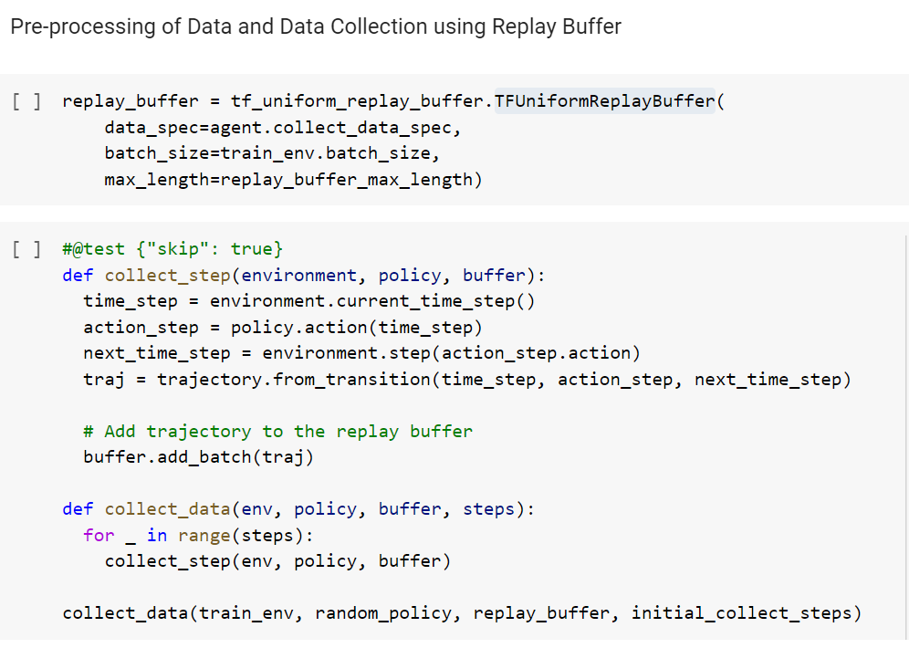
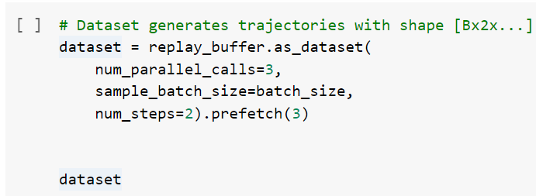
Replay Buffer

Slide 23
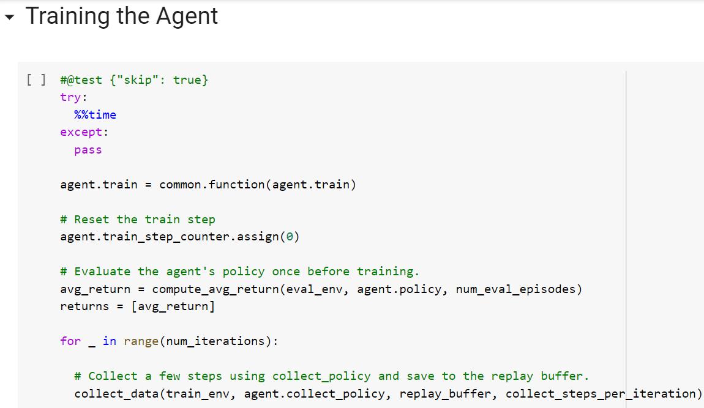
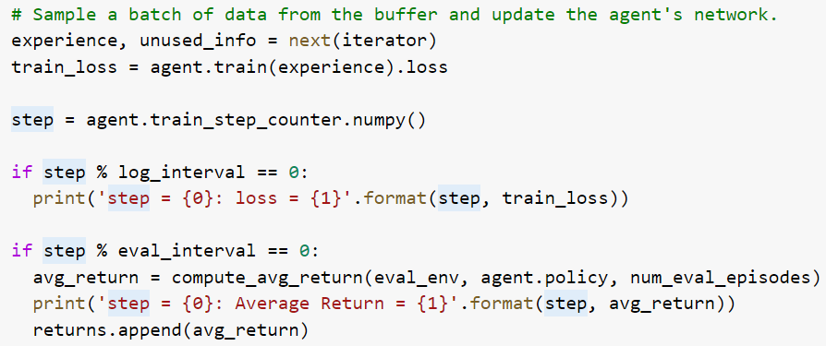
Training the Agent

Slide 24
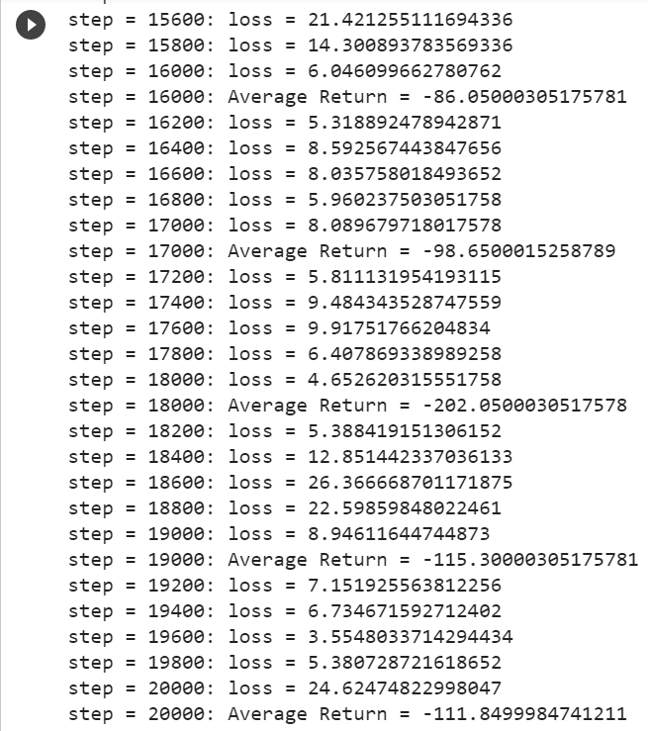
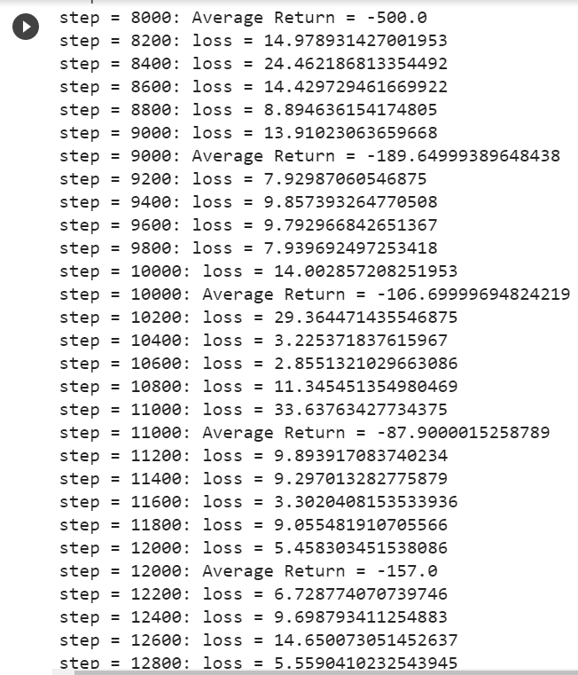
Training the Agent

Slide 25
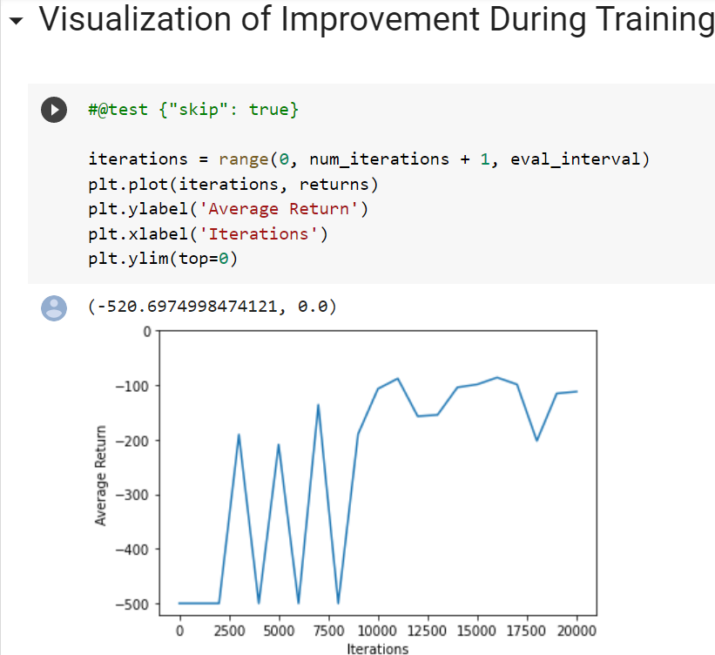
Visualization of Training Improvement

Slide 26
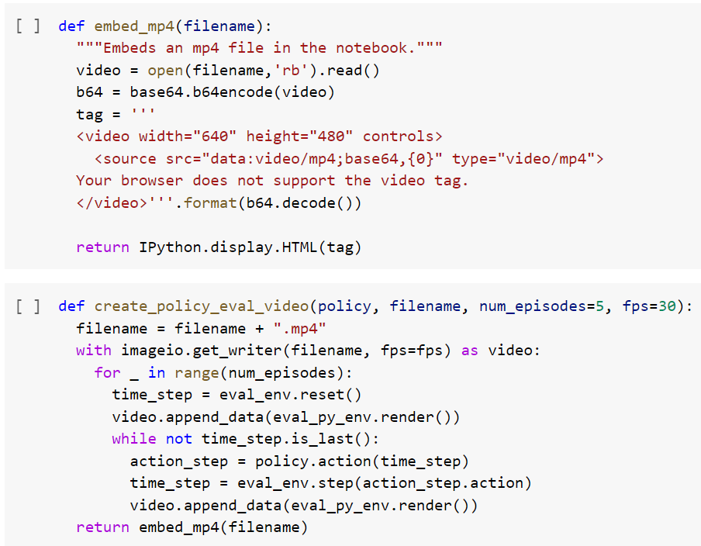
Functions to Create Video

Slide 27
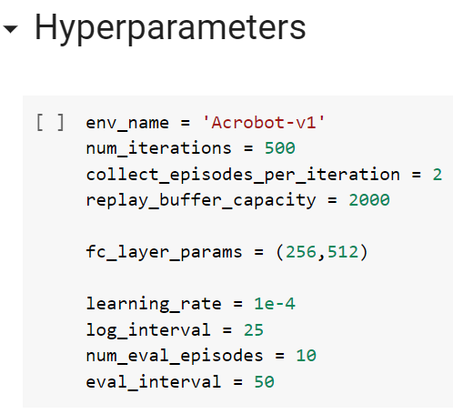
Improved Model
Utilizes REINFORCE Agent
Similar in code, but different packages
Same metrics for evaluation

Slide 28
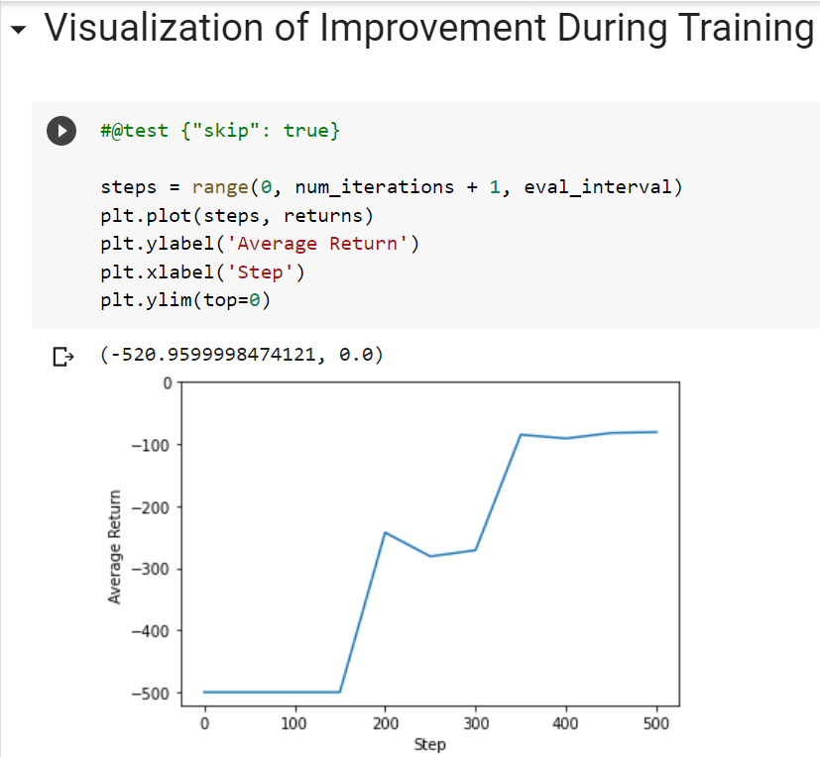
Visualization of Training Improvement

Slide 29
Improvements to be made
Optimize Hyperparameters using Grid Search
Try to utilize other techniques and agents
Soft Actor-Critic (SAC)
https://arxiv.org/abs/1801.01290
Proximal Policy Optimization (PPO)
Double DQN

